Slide 1
How to best attack the afebrile
P. vivax parasite reservoir?

Slide 2
Burden of relapses in interventional cohort study in PNG
511 children age 5-10 yrs of age
Randomised to
  AL (3d) & CQ (3d) plus PQ (20d, 0.5mg/kg), or
  AL & CQ plus Placebo (20d)
9 months active and passive follow-up (Aug – April)

Slide 3
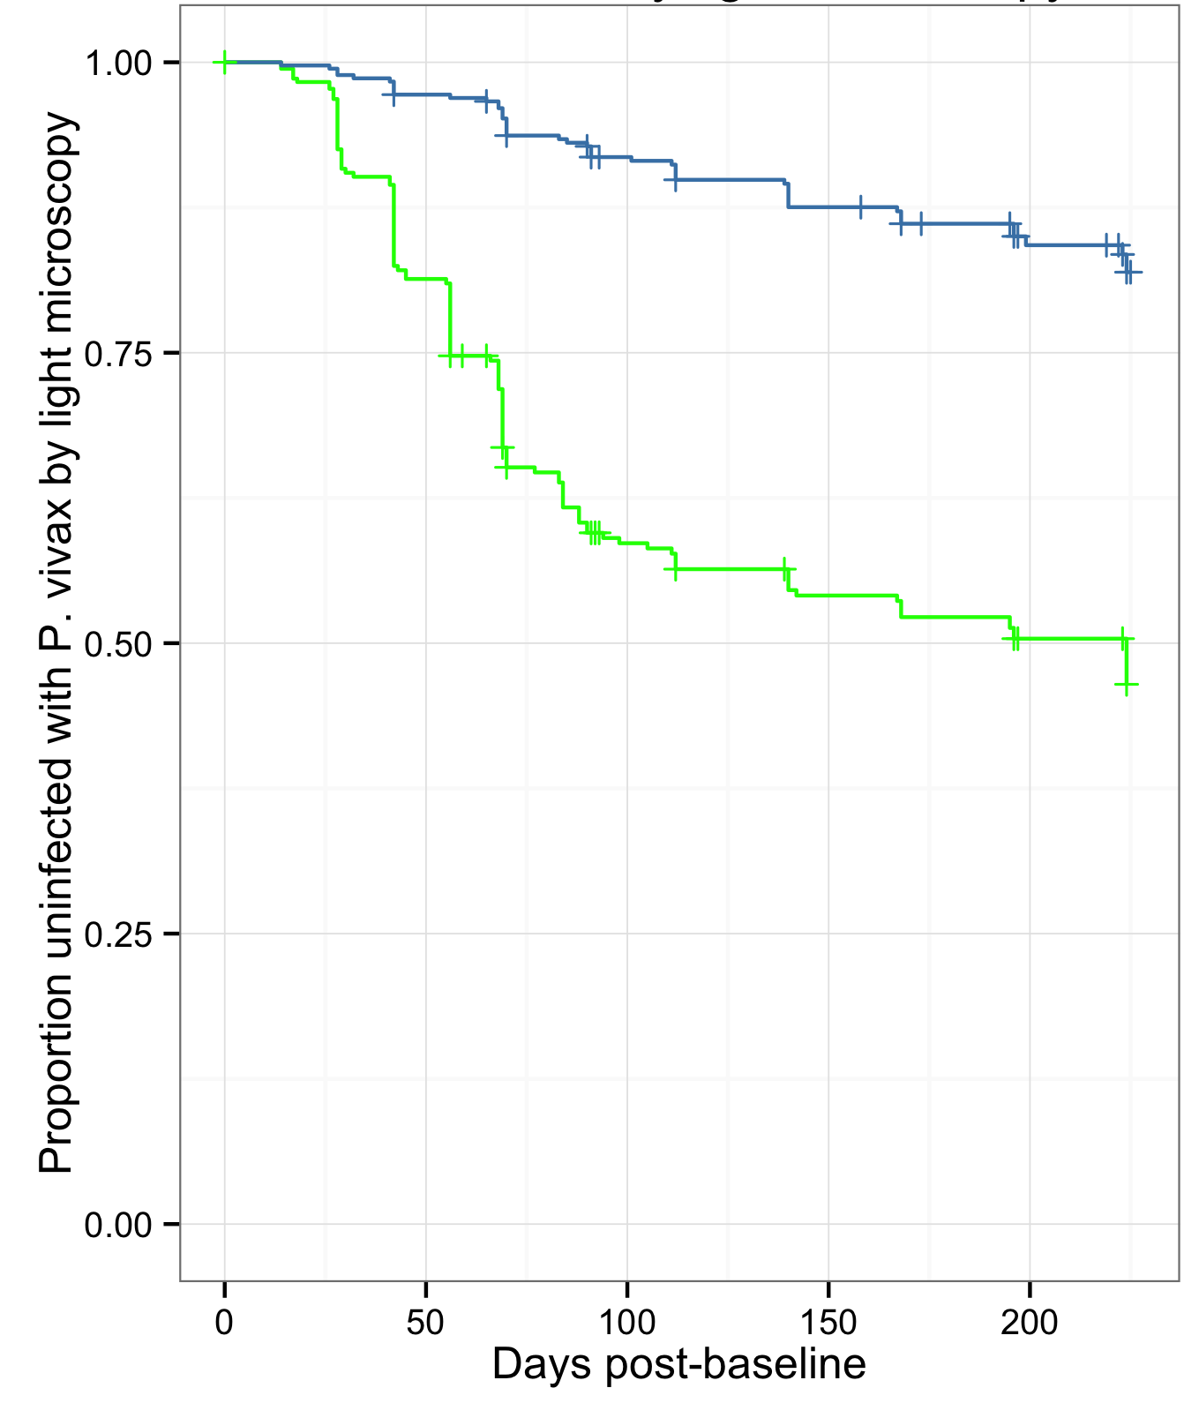
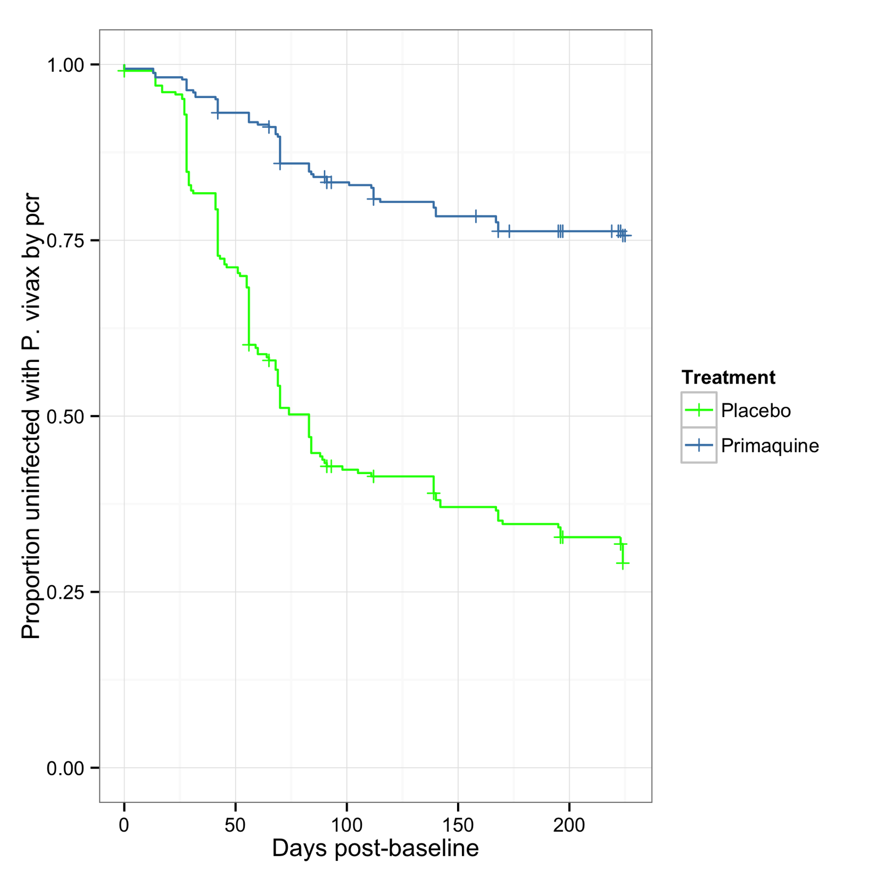
Time to first P. vivax infection
Time to first P. vivax infection by LM
Time to first P. vivax infection by PCR
26%
70%
 | HR | 95% CI | p-value
Light microscopy | 0.16 | [0.08, 0.25] | <0.0001
PCR | 0.20 | [0.14, 0.27] | <0.0001
Gametocytes | 0.24 | [0.16, 0.35] | <0.0001
PQ treatment associated with a ~80% reduction in the risk of acquiring new P. vivax blood-stage infections compared to placebo

Slide 4
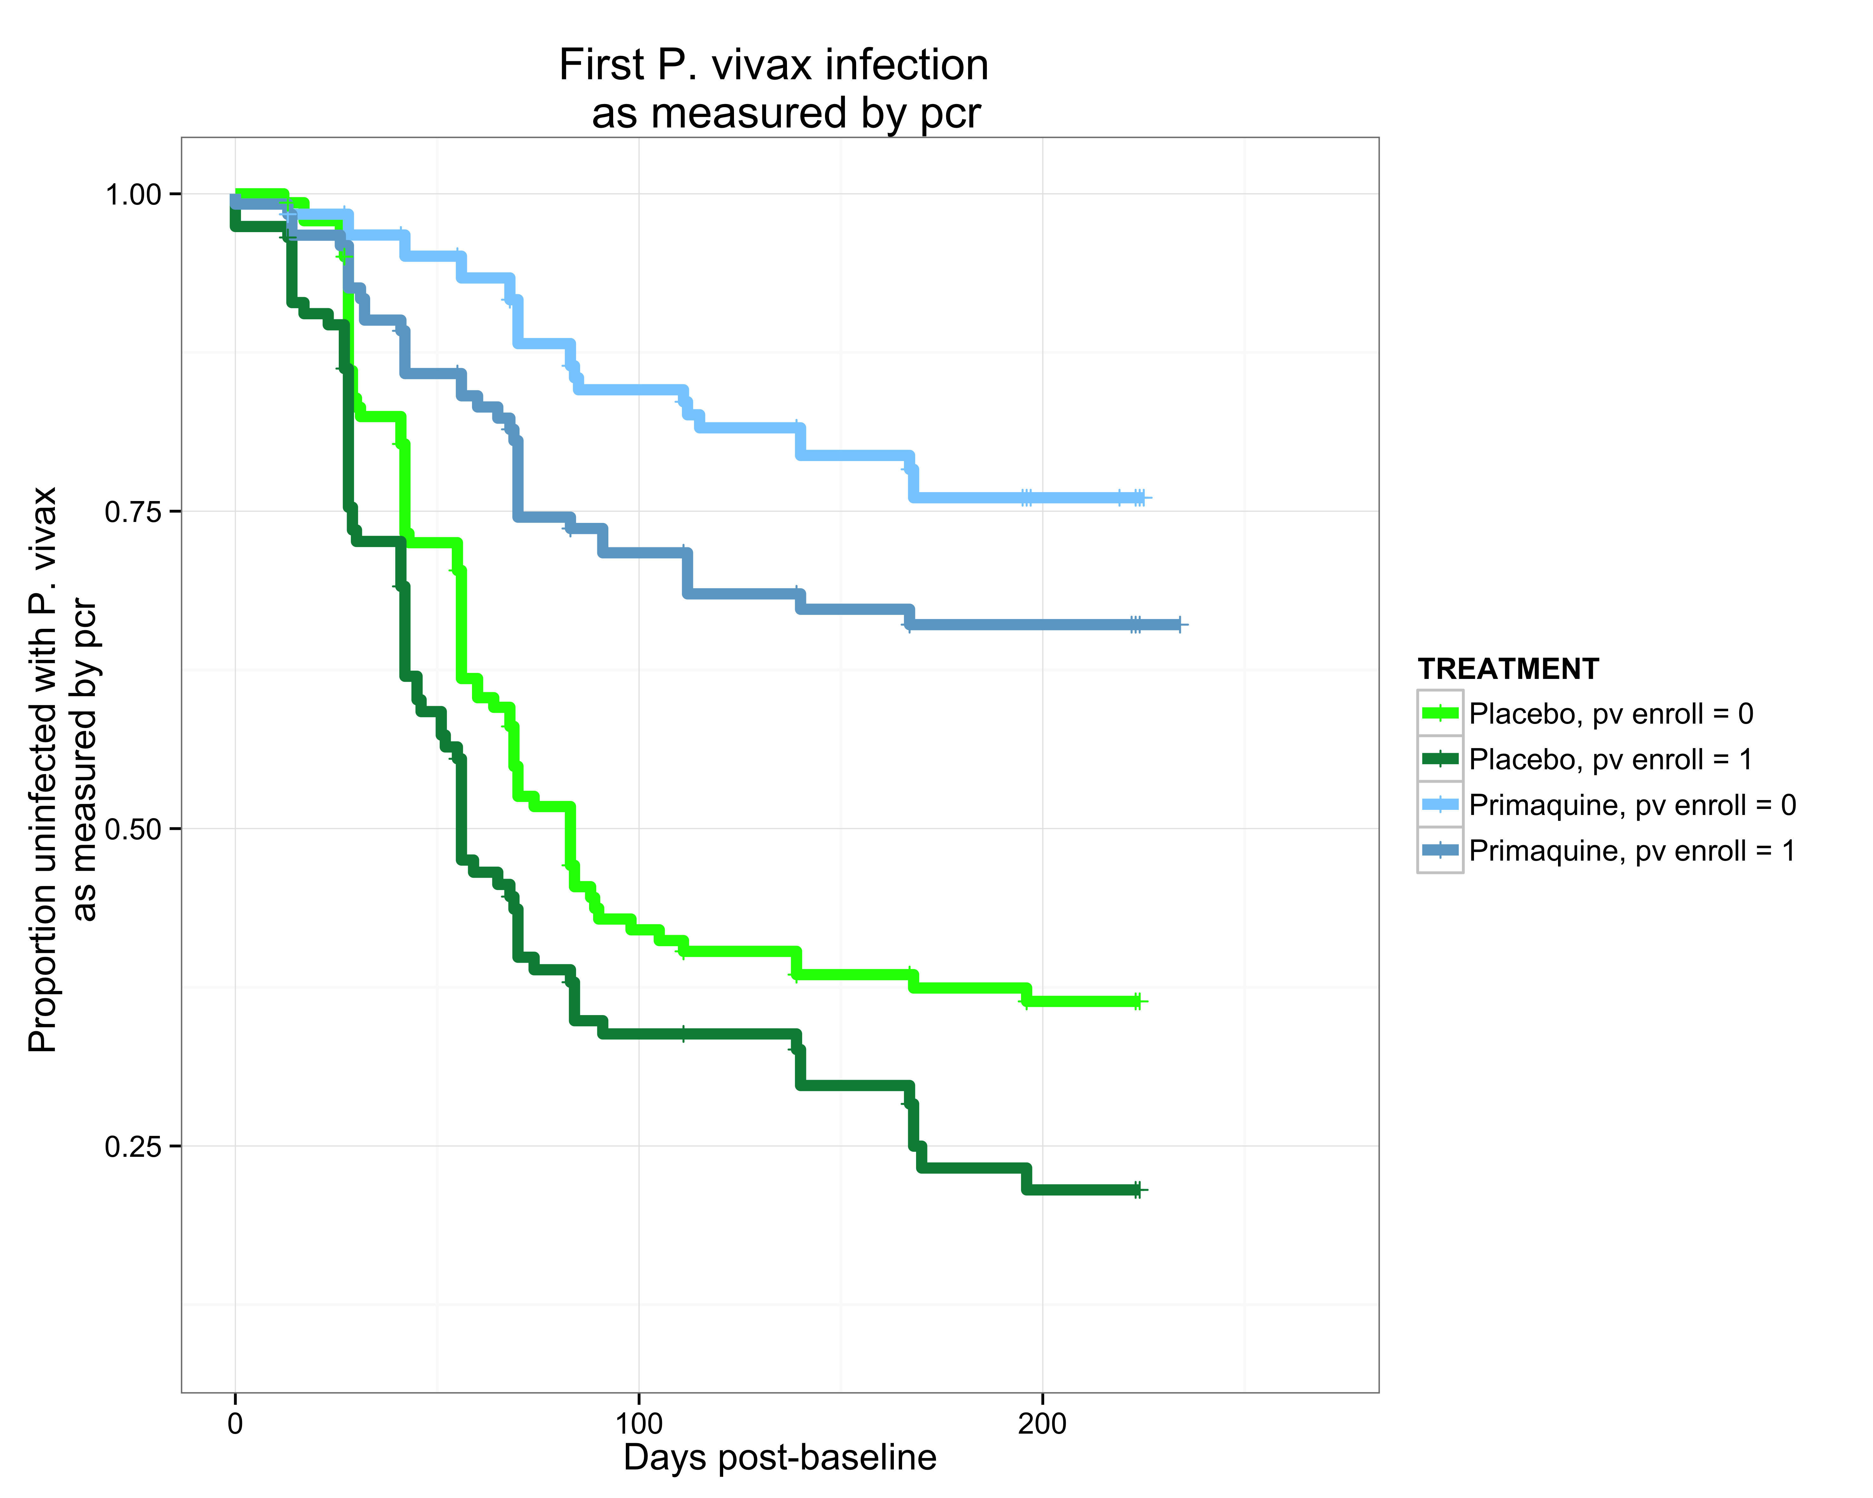
Association of infection status on risk of recurrent P. vivax parasitaemia
  Presence of a P. vivax blood-stage infections is a poor predictor of relapse risk!
Robinson, Wampfler et al in prep

Slide 5
Mass Screen & Treat for P. vivax?
Recurrent P. vivax infections at 3 month
No treatment: 78.4%
following MST (with 1 month post treatment prophylaxis)
  blood stage only: 56.3% (PE = 28%)
  BS plus PQ: 38.9.3% (PE = 50%)
MDA
  BS only: 46.6% (PE = 41%)
  BS plus PQ: 11% (PE = 86%)

