Slide 1
“Alineamento entre los principales actores, estructuras de governanza, y rendicion de cuentas para la eliminacion de la malaria en Mesoamerica y La Espanola”

Slide 2
“Governance”
Working definition: Governance for malaria is the collection of systems and organizations necessary to guide progress toward international malaria goals.
Key aspects include:
Setting strategic goals, and advocating for /facilitating access to the tools necessary to accomplish them
Monitoring progress toward goals
Accessing expertise necessary to shape approaches
Fostering investment in needed new technologies

Slide 3
Framework for key governance activities
“Four Essential Functions of the Global Health System.”
Production of Global Public Goods
“Research and development, standards
and guidelines, and comparative
evidence and analyses”
Management of Externalities Across Countries
“Research and development, standards
and guidelines, and comparative
evidence and analyses”
“Development financing, technical cooperation, humanitarian assistance, and agency for the dispossessed”
Mobilization of Global Solidarity
“Convening for negotiation and consensus
building, priority setting, rule setting,
evaluation for mutual accountability,
and cross-sector health advocacy”
Stewardship
Source: Frenk, J. et al. “Governance Challenges in Global Health” NEJM March 2013.

Slide 4
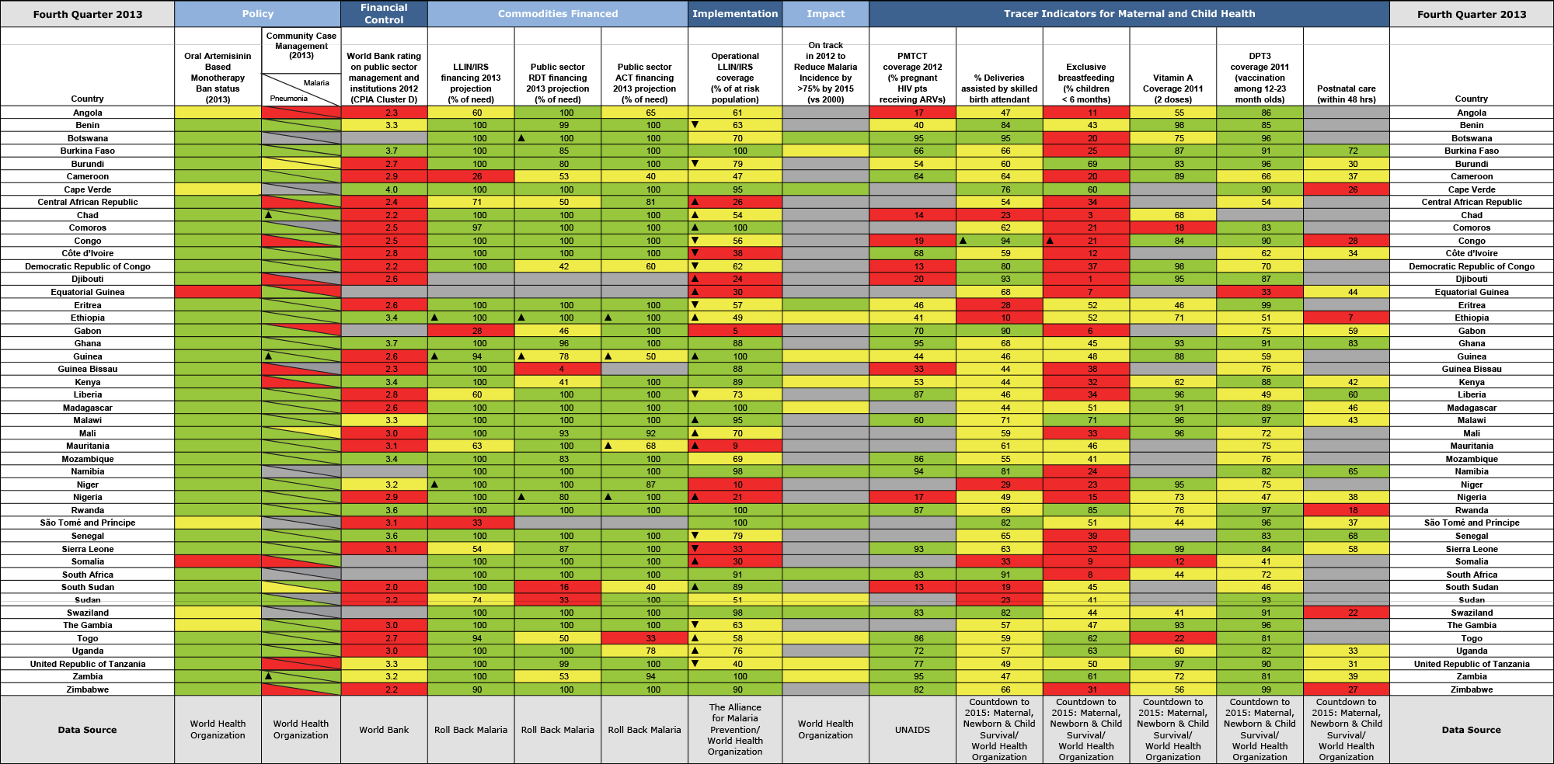
ALMA Scorecard - accountability

