Slide 1

malaria in brazil
(an untold story...)
Eliminación de la Malaria en Mesoamerica y La Española
16-21 de febrero de 2014
San Salvador, El Salvador
marcus lacerda MD, PhD
Fundação de Medicina Tropical Dr. Heitor Vieira Dourado
Universidade do Estado do Amazonas

Slide 2
american malaria history

Slide 3
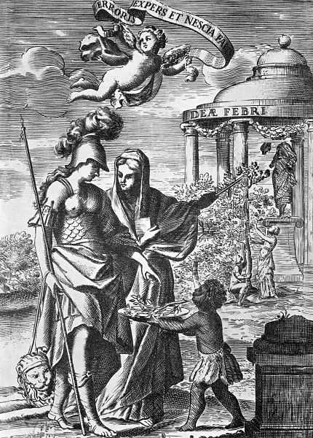
Quinine discovery in Peru

Slide 4
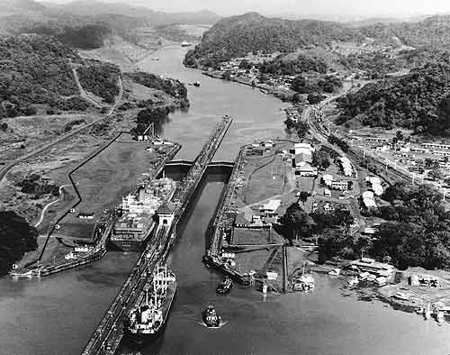
Panama Canal

Slide 5
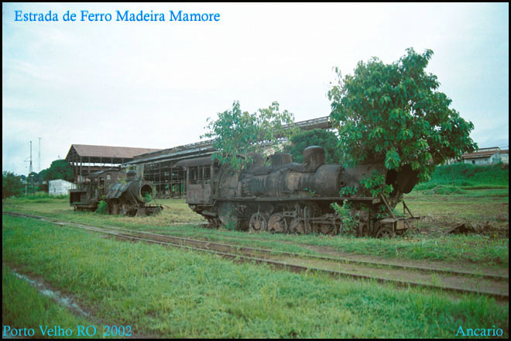
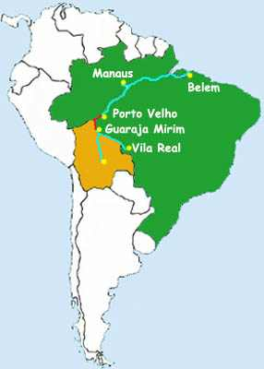
Madeira-Mamoré Railway

Slide 6
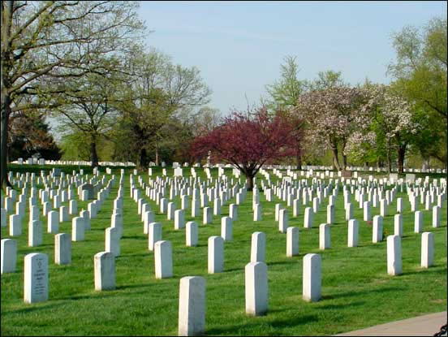
Vietnam War

Slide 7
malaria in the present days in the americas…

Slide 8
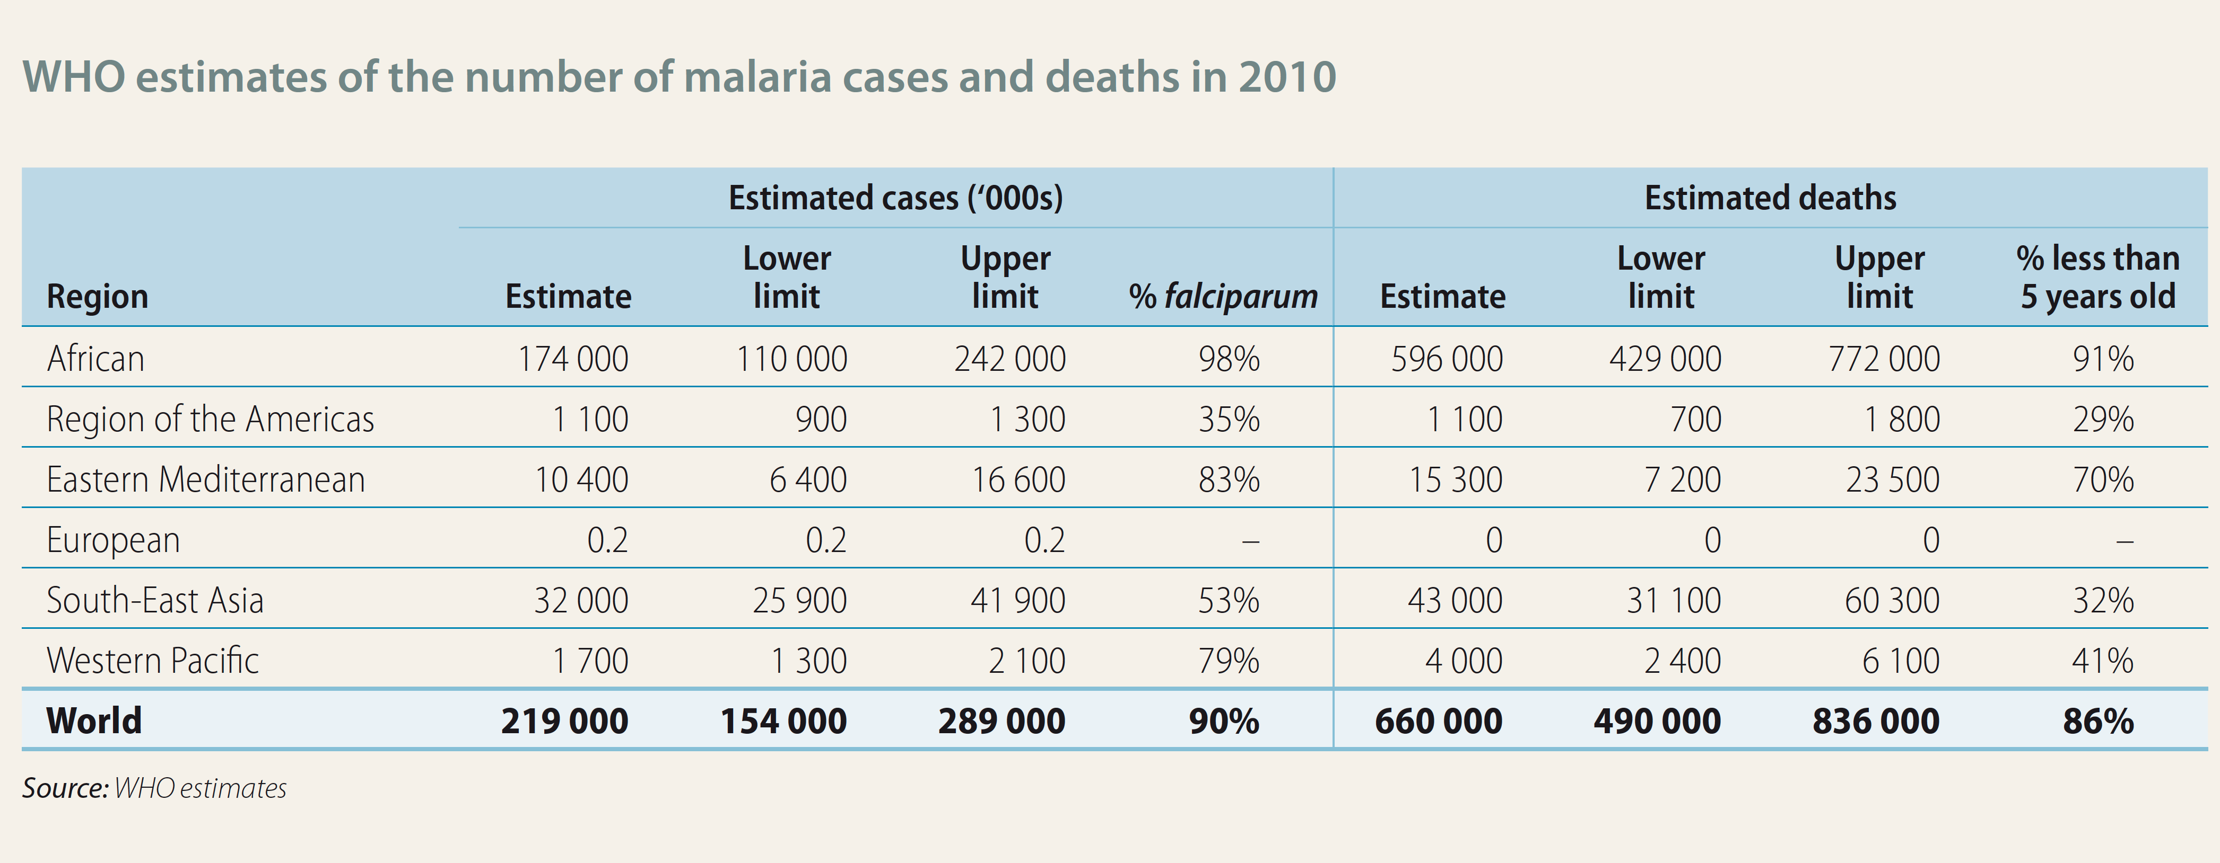
world malaria report 2012

Slide 9
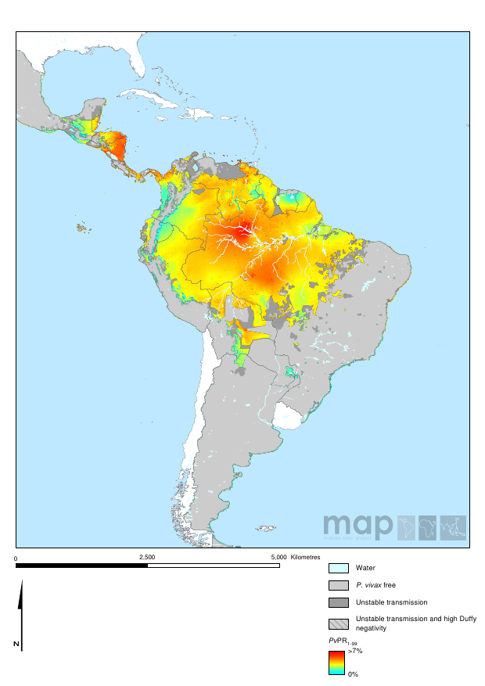
P. vivax prevalence

Slide 10
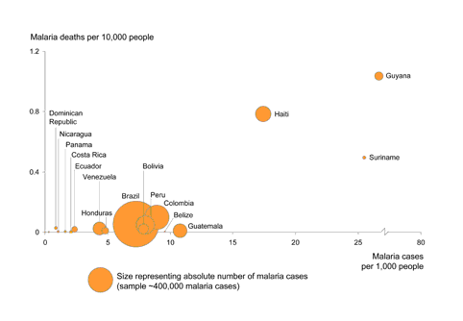
fatality burden

Slide 11
vectorial determinants

Slide 12
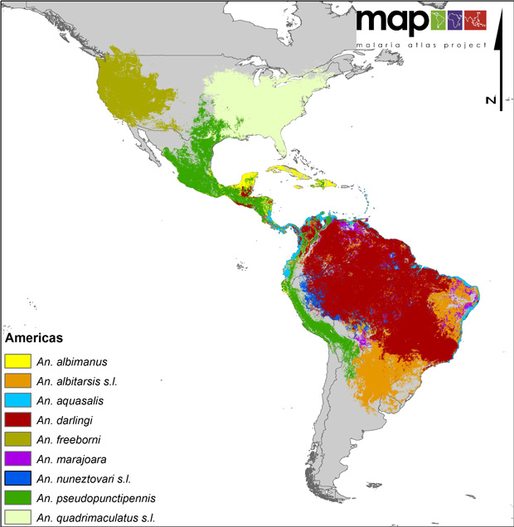

Slide 13
human determinants

Slide 14
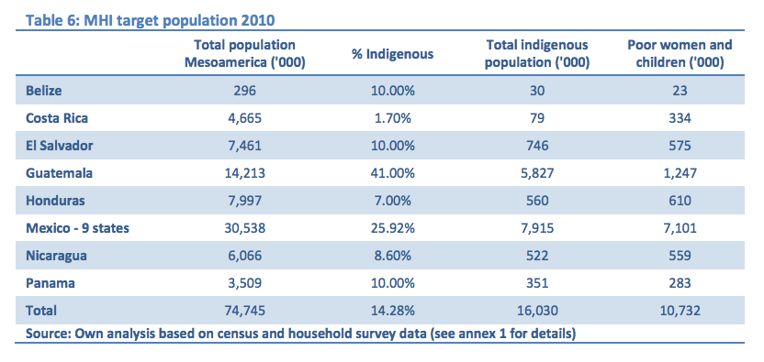
indigenous population

Slide 15
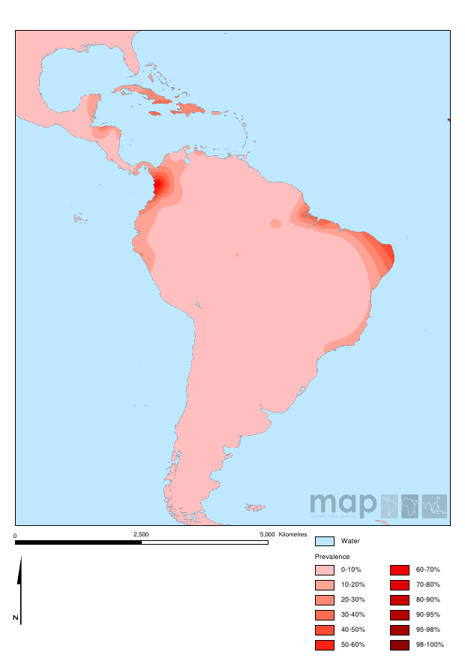
Duffy negative prevalence

Slide 16
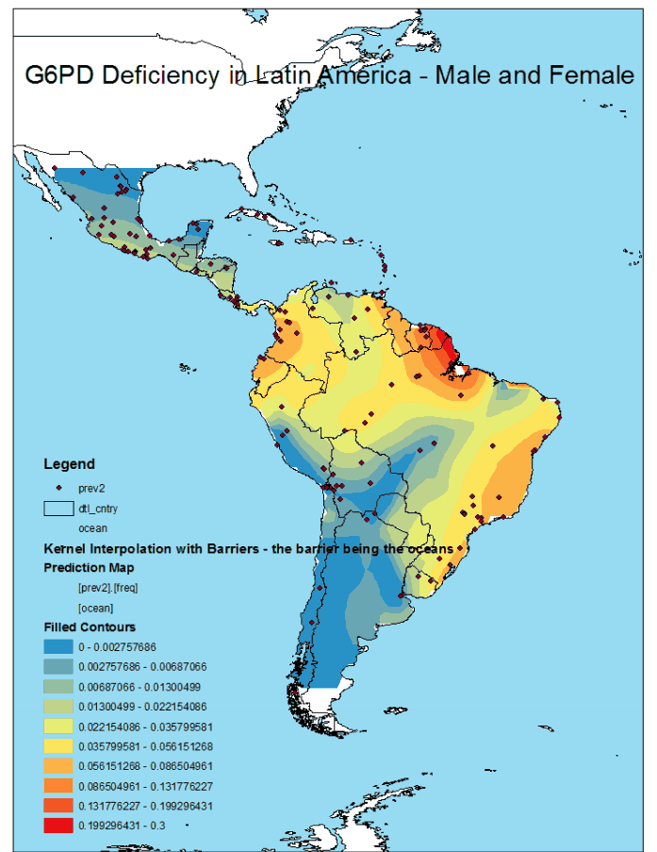
G6PDd
prevalence
Monteiro et al., (unpublished data)

Slide 17
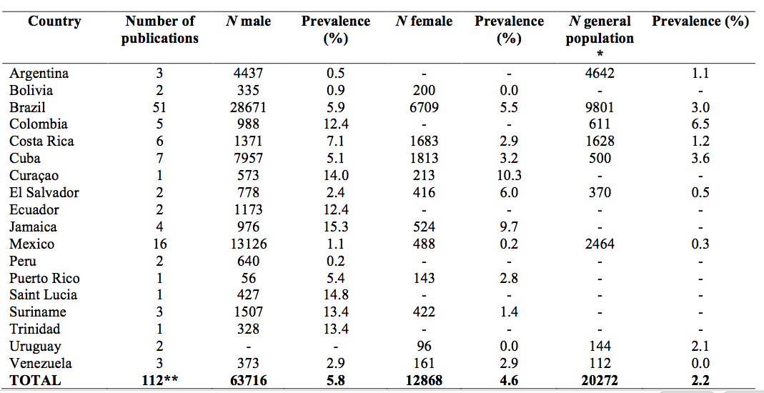
G6PDd prevalence
Monteiro et al., (unpublished data)

Slide 18
change in clinical patterns?

Slide 19
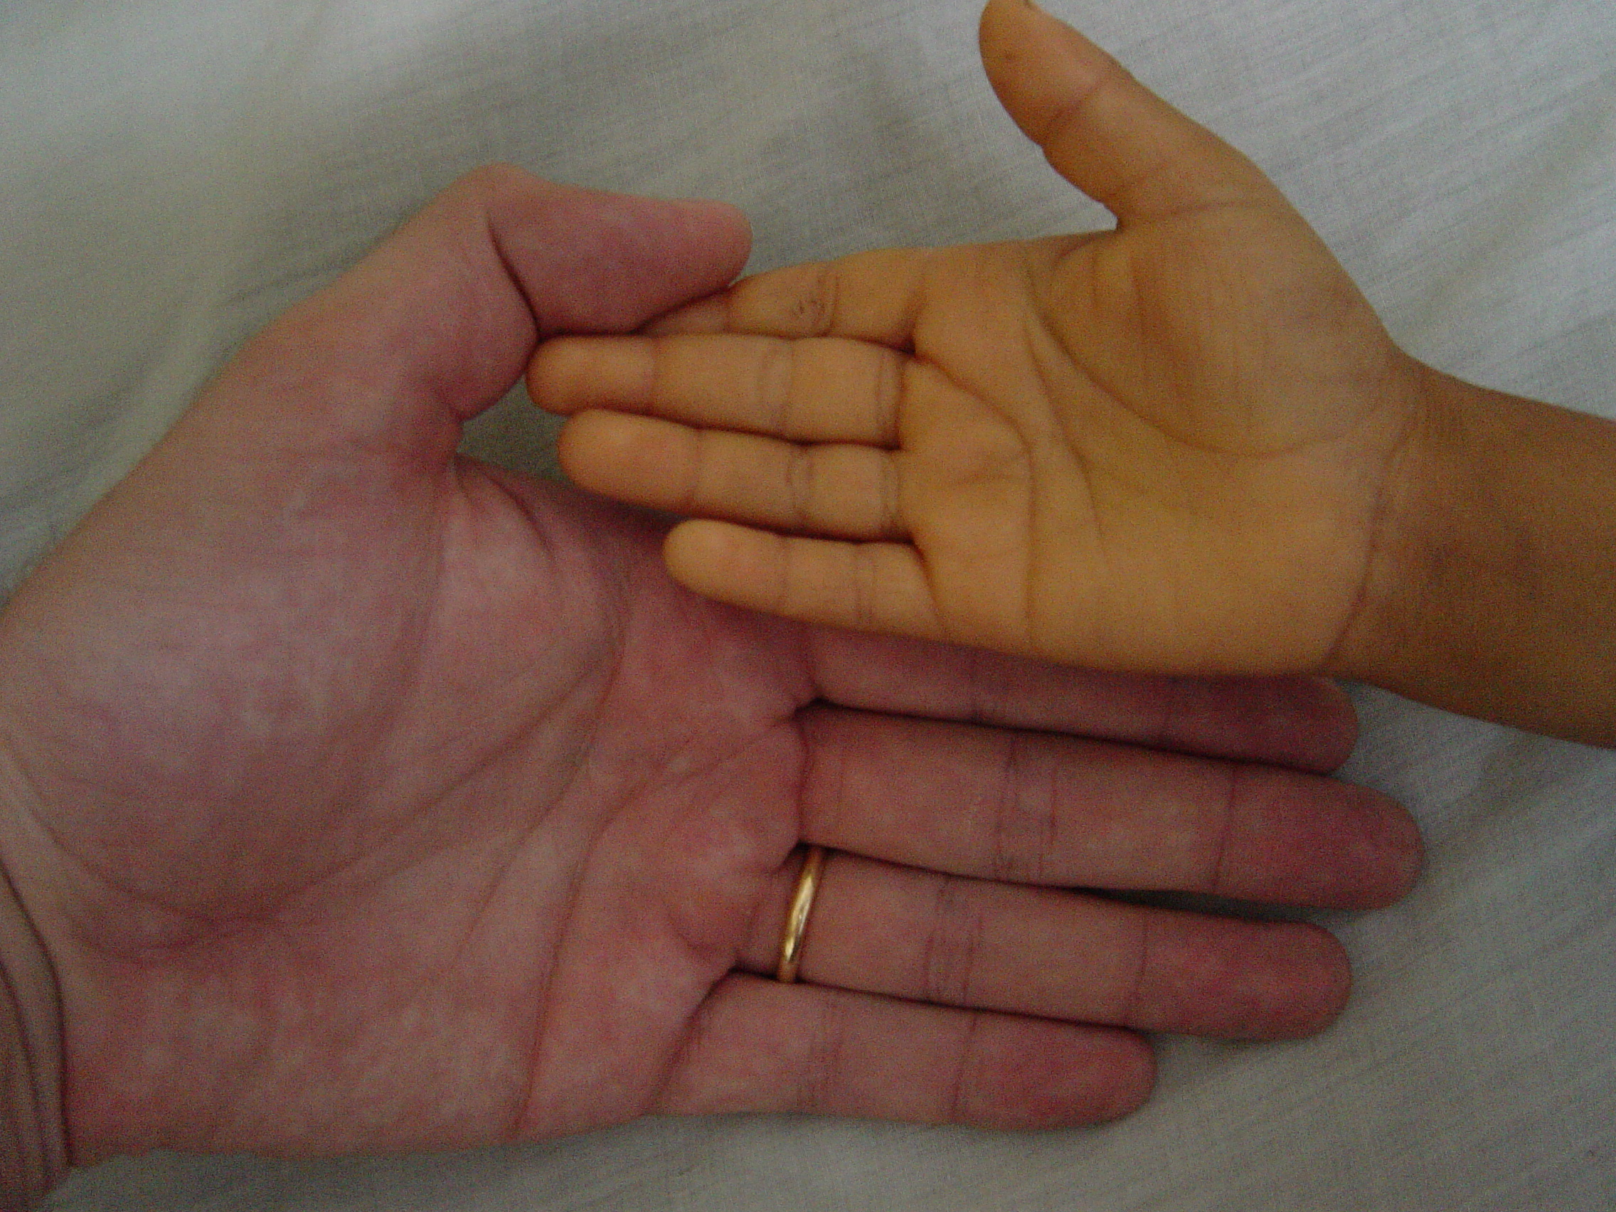

Slide 20
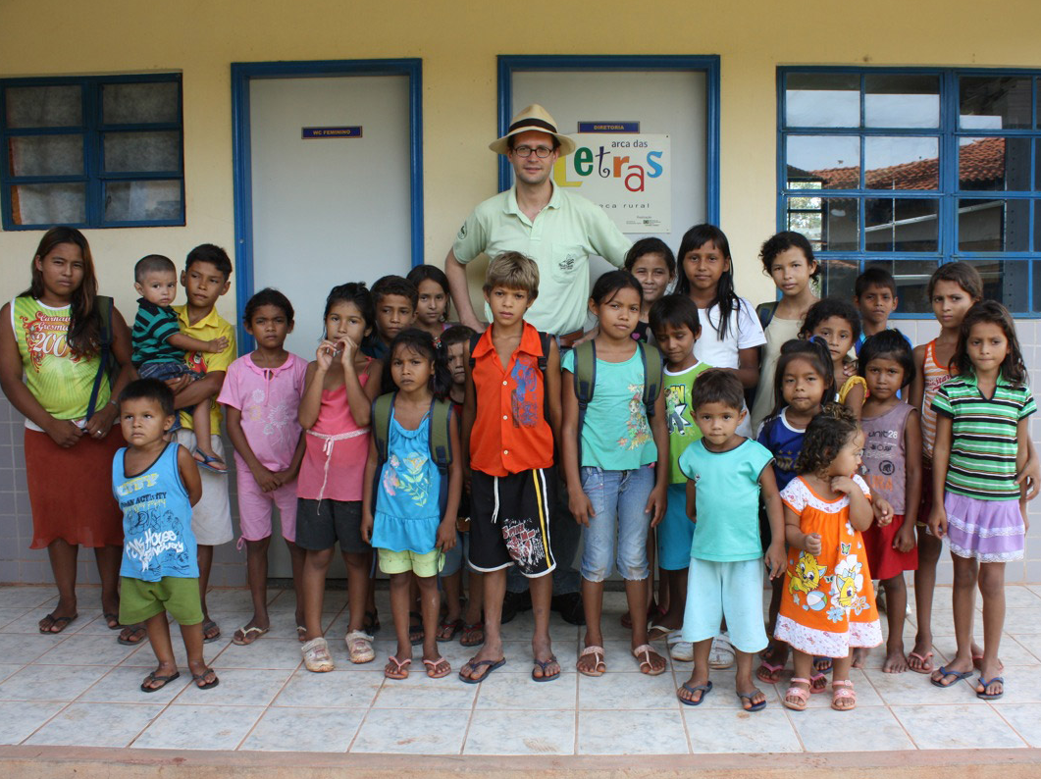

Slide 21
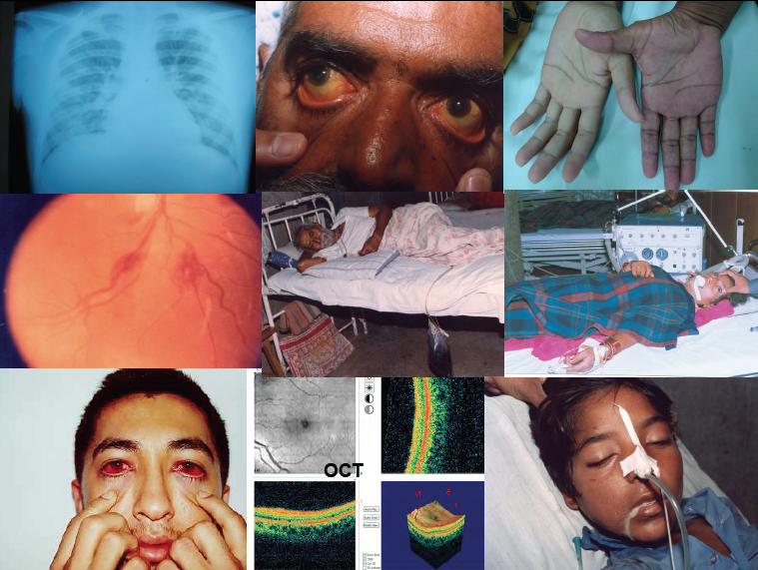

Slide 22
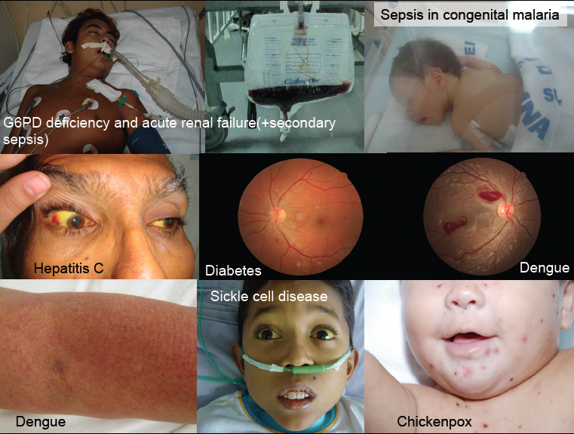

Slide 23
malaria in brazil

Slide 24
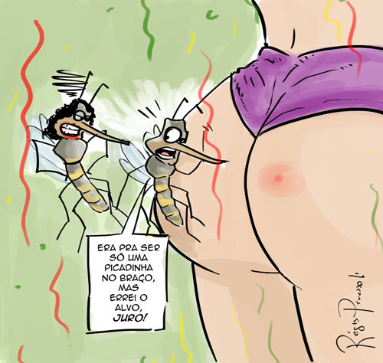
is it different due to any reason?
Animate, es Carnaval en Brasil

Slide 25
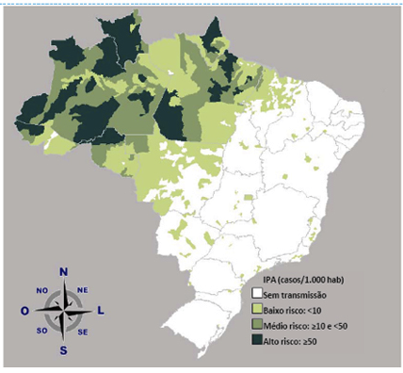
malaria in brazil in 2010
5,217,423 km²

Slide 26
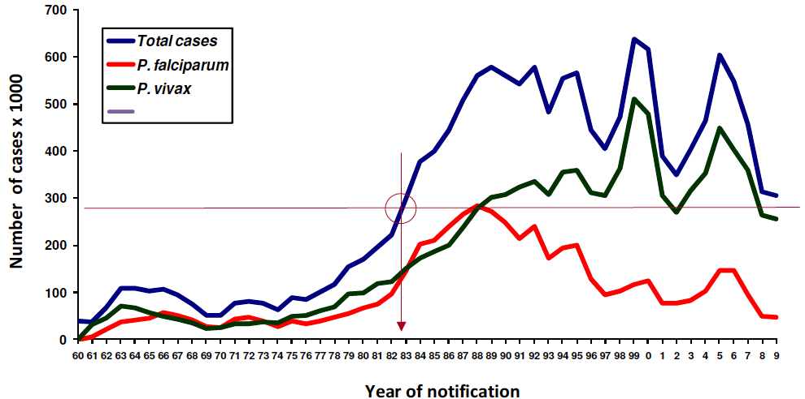
malaria epidemiology in brazil
Oliveira-Ferreira et al., Malaria J 9 (1), 2010

Slide 27
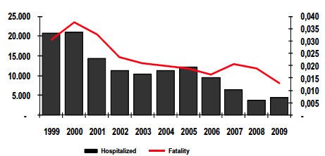
malaria hospitalization trends in brazil
Total number of cases
%
Trends per species in a tertiary care center in the Amazon
%
%
Santos-Ciminera et al., EID 13 (10), 2007
Year

Slide 28
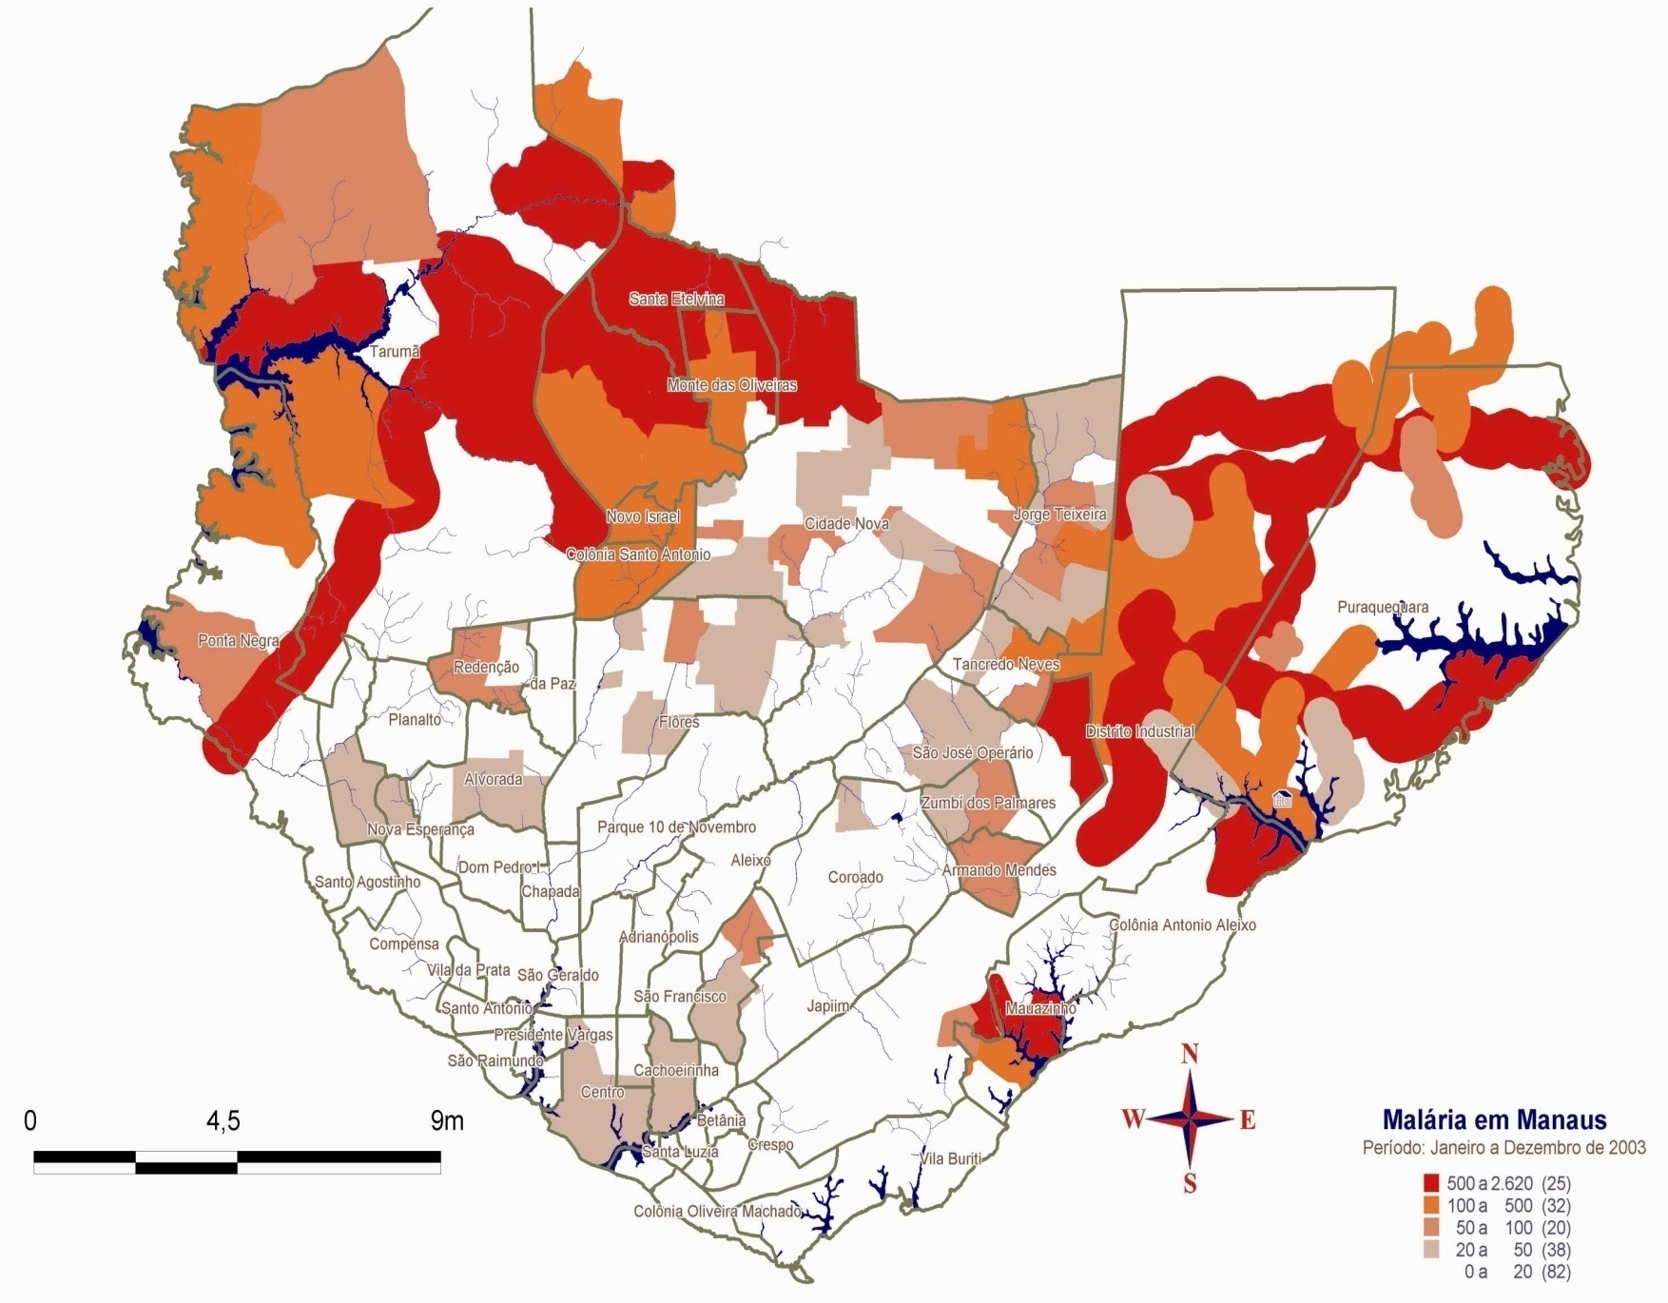
malaria in manaus

Slide 29
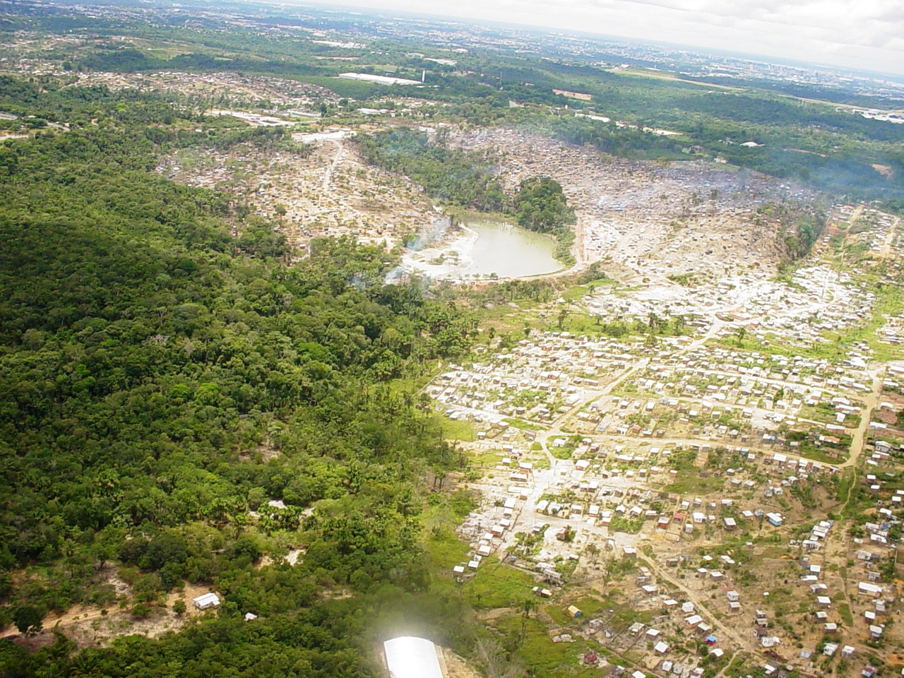

Slide 30
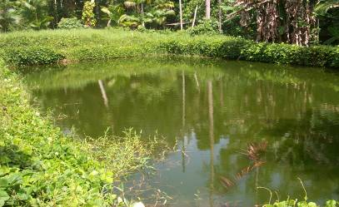
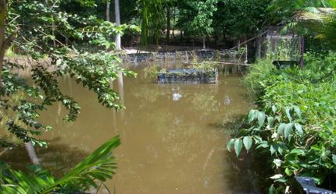
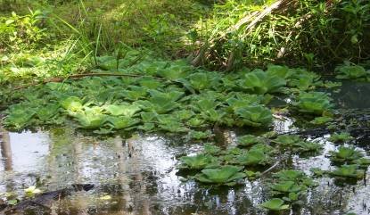
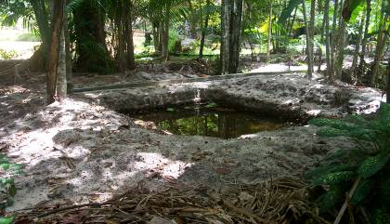

Slide 31
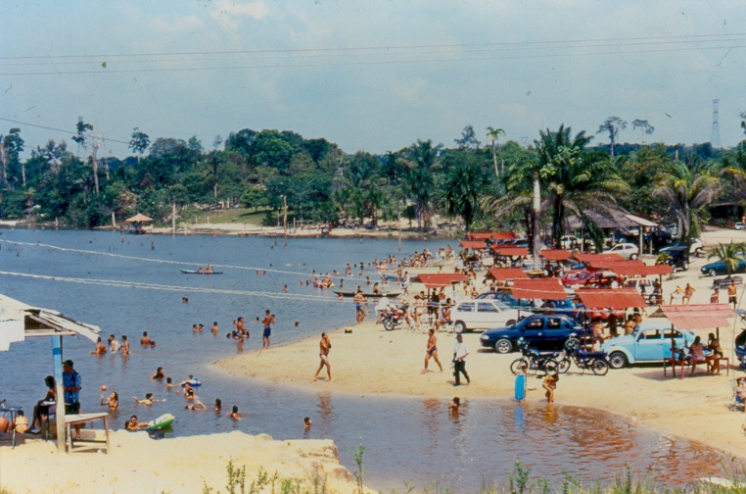

Slide 32
successful points in the control

Slide 33
successful points in the control
Political:
  National governance
  Infrastructure set up during the Malaria Eradication Campaign in the 1950s (leaderships trained)
  National vertical program until 2001
  Public health improvement

Slide 34
successful points in the control
Operational:
  Diagnosis based on routine microscopy with quality control (mostly before 48 hours of symptoms)
  Active search of asymptomatic
  House spraying (?)
  Good information system (SIVEP-Malaria since 2003)
  Focus on priority areas

Slide 35
successful points in the control
Anti-malarial policies:
  Exclusive distribution by the government
  National guidelines
  National production (Farmanguinhos)
  Primaquine single dose for Pf
  Primaquine 0.5mg/kg/d for 7 days for Pv
  ACTs for severe Pf in the 1990s
  ACTs for non-severe Pf in 2007
  Resistance surveillance in the research references

Slide 36
successful points in elimination

Slide 37
pre-elimination outside the amazon

Slide 38
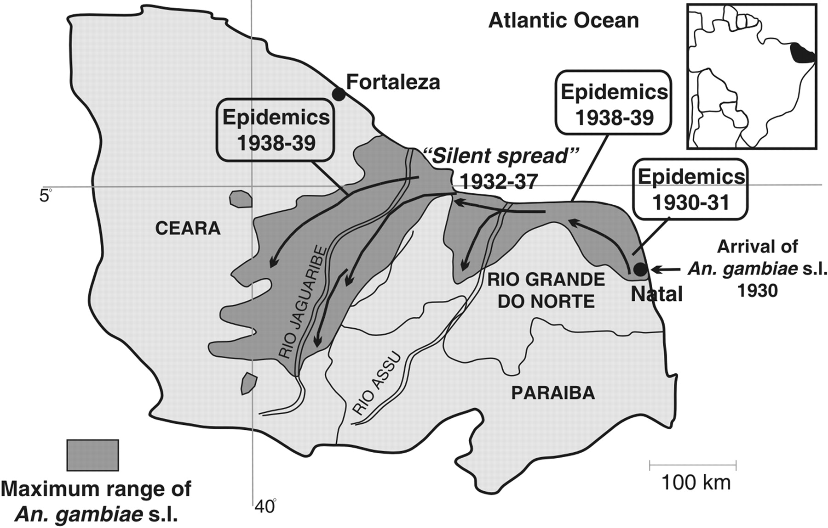

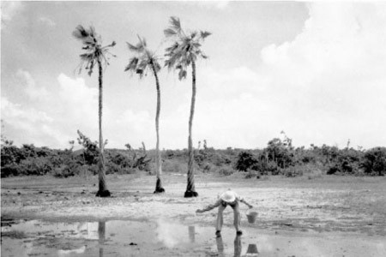
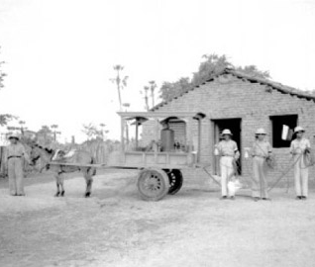

Slide 39
problems…

Slide 40
problems...
Urban population trends
Increased migration
Mining areas
Indigenous populations
High fatality rate outside the Amazon
Low coverage of bednets and RDTs
Low asymptomatic detection capacity
Pv chloroquine resistance
Primaquine use (compliance and safety)

Slide 41
problems...
Ongoing process of descentralization
Lack of interaction with neighbouring countries
Lack of interaction with other programs (careers in malaria)
Lack of objective goals
Lack of persistent political interest

Slide 42
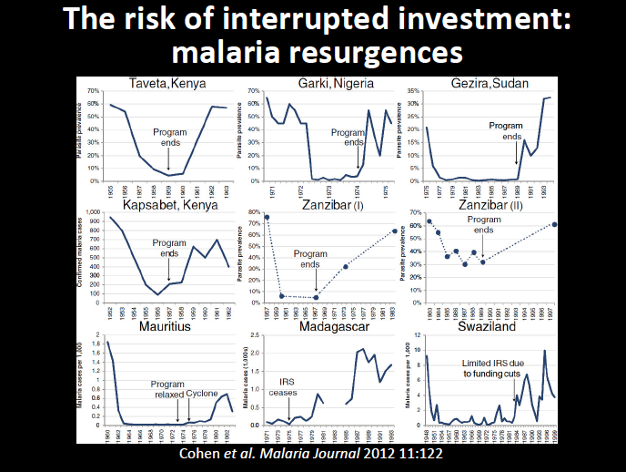

Slide 43
Need for innovation

Slide 44
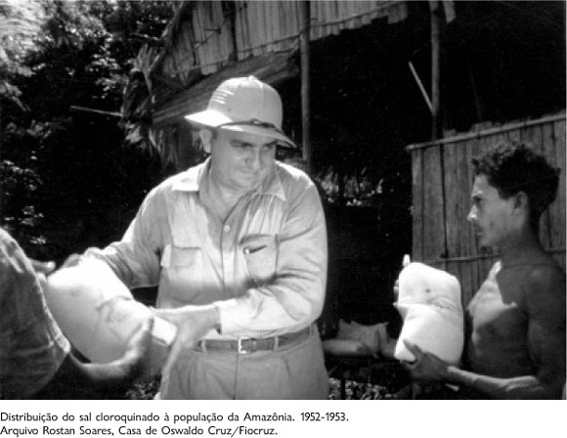

Slide 45
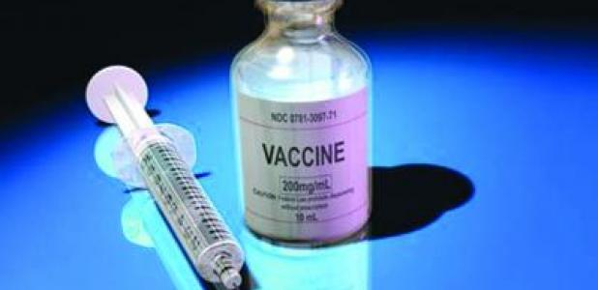

Slide 46
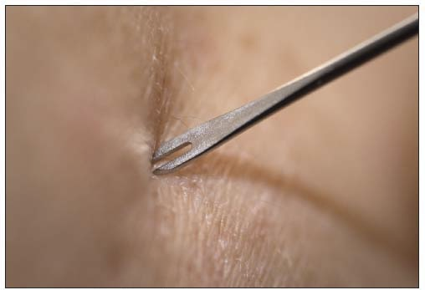

Slide 47


Slide 48


Slide 49
pharmacological strategies for elimination: the role of the radical cure
Eliminación de la Malaria en Mesoamerica y La Española
16-21 de febrero de 2014
San Salvador, El Salvador
marcus lacerda MD, PhD
Fundação de Medicina Tropical Dr. Heitor Vieira Dourado
Universidade do Estado do Amazonas

Slide 50
P. falciparum

Slide 51

Official First-Line Treatment for
Uncomplicated P. falciparum Malaria, 2002
ACT
Other CT
CQ
MQ
Q7d+D7d
AQ + SP
Monotherapy
CQ
Q3d+D7d
ASU+SP
ASU+MQ
ASU+MQ
Malaria transmission area

Slide 52
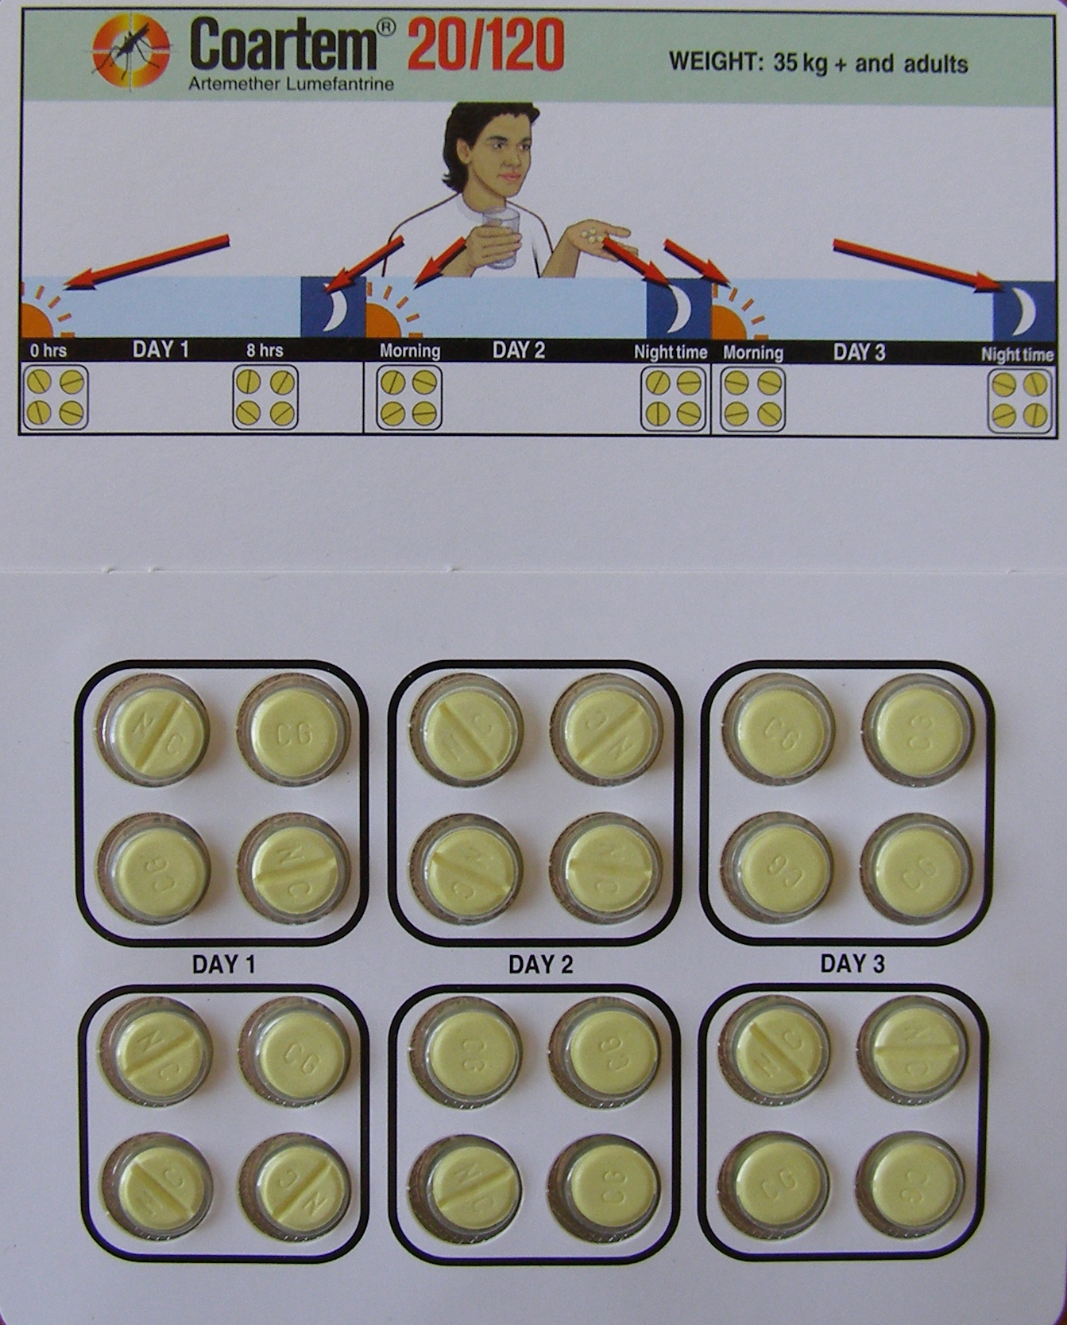
Falciparum malaria treatment
Adults
Day 1
Day 1
Day 2
Day 3
Primaquina
15mg

Slide 53
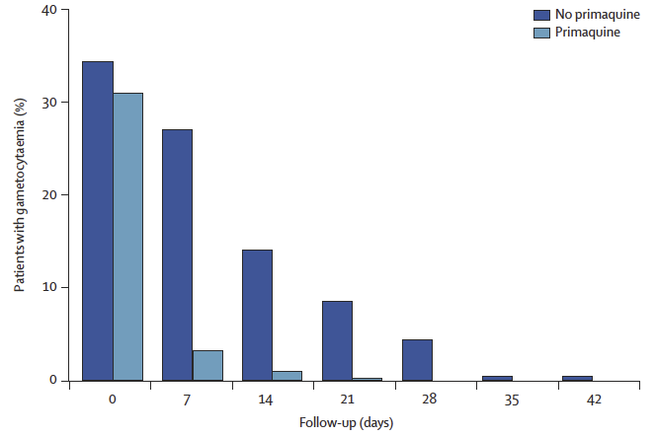
role of primaquine in Pf gametocyte treatment
Smithuis et al., Lancet Infect Dis, 2010

Slide 54
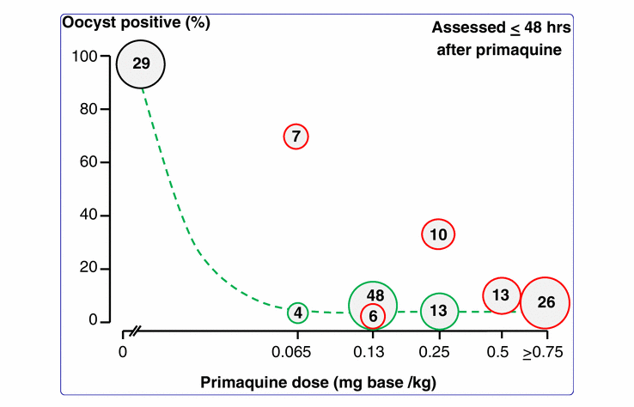
efficacy of low dose of primaquine in Pf treatment
White et al., Malaria J, 2012

Slide 55
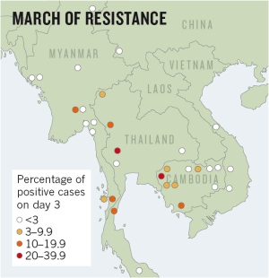
Pf artemisinin resistance

Slide 56
P. vivax

Slide 57
Vivax malaria treatment
Adults
Day 1
Day 2
Day 3
Cloroquina
150mg
Cloroquina
150mg
Cloroquina
150mg

Slide 58
Vivax malaria treatment
Adults
Day 1
Day 2
Day 3
Day 4
Day 5
Day 6
Day 7
Primaquina
15mg
Primaquina
15mg
Primaquina
15mg
Primaquina
15mg
Primaquina
15mg
Primaquina
15mg
Primaquina
15mg

Slide 59
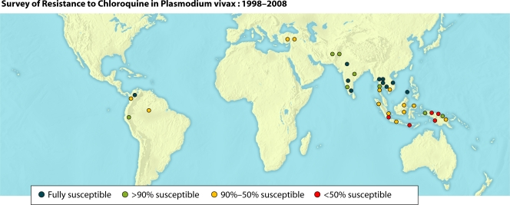
chloroquine-resistant Plasmodium vivax
Baird, Clin Microbiol Rev 22 (3), 2009

Slide 60
Risk difference = 21.58% (p<0.0001)
Most of the recurrences are asymptomatic
CQ x ASAQ in the brazilian amazon
Siqueira et al., in preparation.

Slide 61
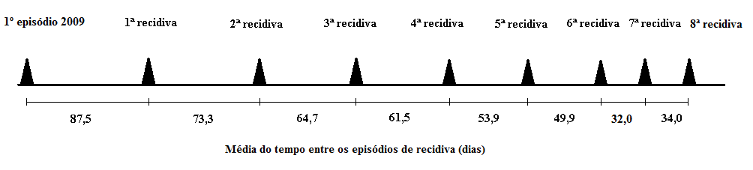
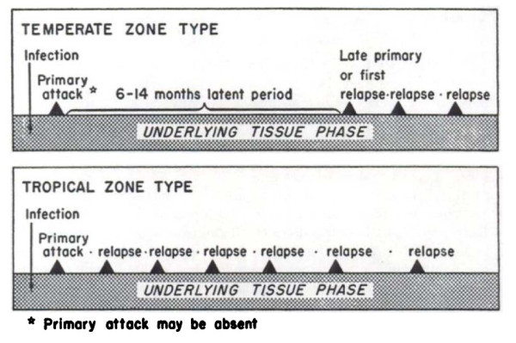
pattern of ‘relapse’
Fontes et al., C Saude Pub, in press
β = -7,57; IC95%: -9,19; -5,95 (p<0,0001)
Hankey et al., Am J Trop Med Hyg 1953.

Slide 62
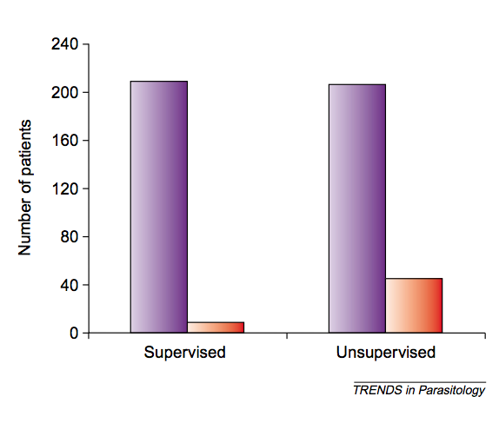
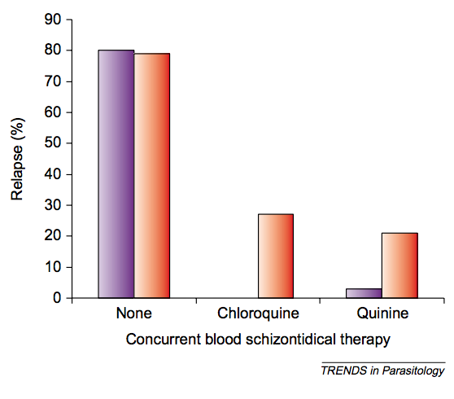
major problems with primaquine…
Baird et al., Trends Parasitol 2013

Slide 63
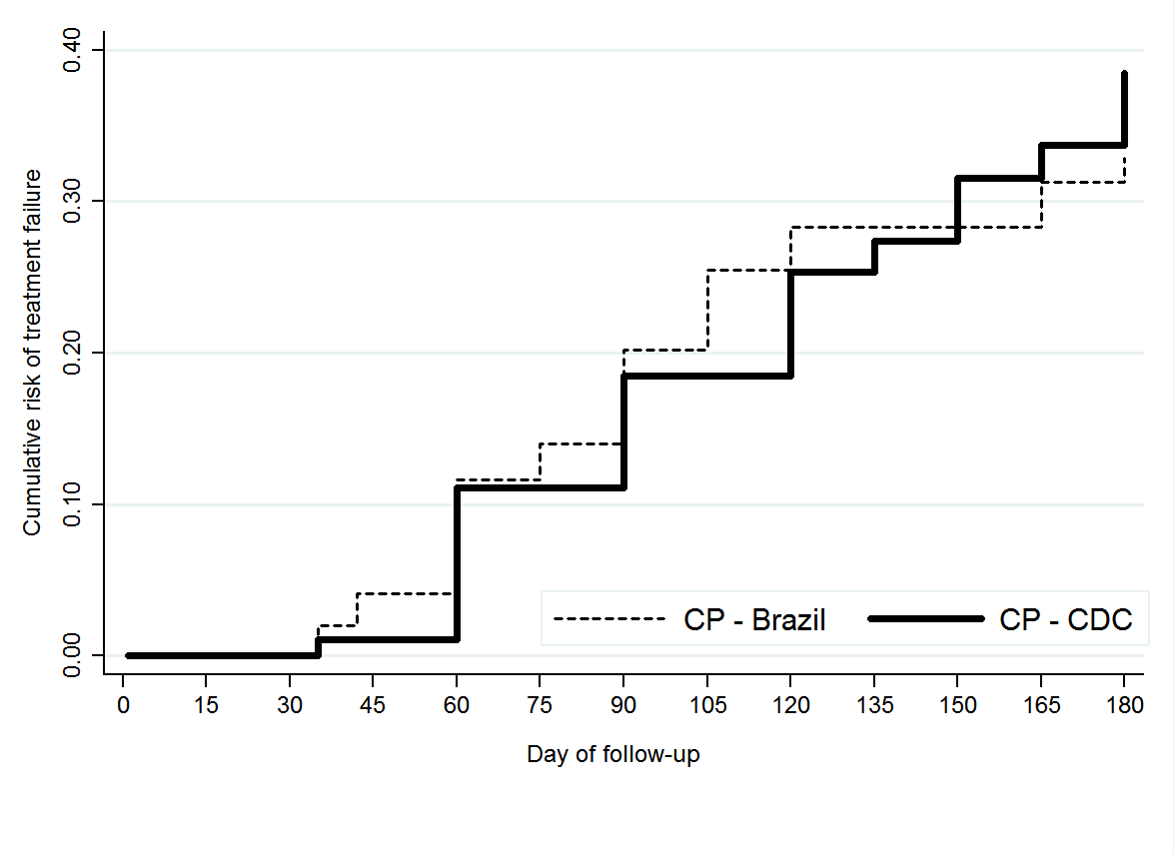
Low efficacy of higher doses of primaquine in Brazil
Santana Filho et al., in preparation

Slide 64
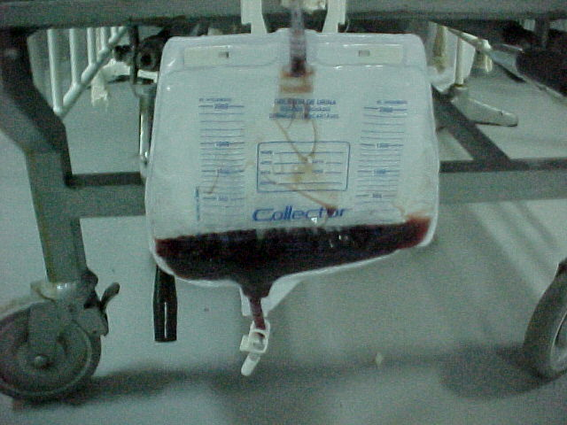

Slide 65
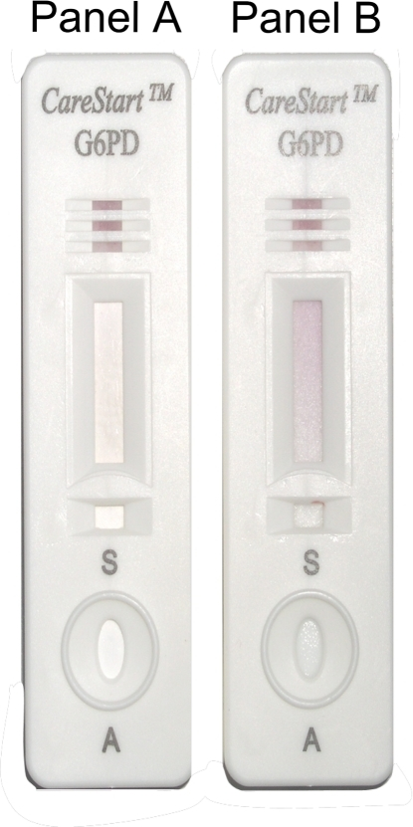
Normal enzyme activity
6,4 UI/gHb (IC95% 6,2-6,6)
Cut-off ~20% of normal activity
≤ 1,5 UI/gHb
 |  | UV-Vis Spectrophotometry
 |  | Deficient | Normal | Total
Carestart G6PD | Deficient | 3 | 6 | 9
 | Normal | 1 | 312 | 313
 | Total | 4 | 318 | 322
Sentivity | 75.00% | IC95% 30,06, 95.44
Especificity | 98.11% | IC95% 95,95, 99.13
Positive Predictive Value | 33.33% | IC95% 12,06, 64,58
Negative Predictive Value | 99.68% | IC95% 95,58, 98.94

Slide 66


Dose Ranging Efficacy Results from the Tafenoquine ‘DETECTIVE’ Trial
(Dose and Efficacy Trial: Evaluation of Chloroquine and Tafenoquine In Vivax Elimination)
Llanos-Cuentas et al., Lancet, December 2013.

Slide 67
Study Design: Dose Ranging Phase 2b
Chloroquine# + 50mg Tafenoquine Day 1 or 2 (n=54)
Double-blind
Randomisation
90% Power
N=324
Chloroquine# + 100mg Tafenoquine Day 1 or 2 (n=54)
6 months follow-up
Chloroquine# + 300mg Tafenoquine Day 1 or 2 (n=54)
Chloroquine# + 600mg Tafenoquine Day 1 or 2 (n=54)
Chloroquine# + 15mg Primaquine⁺ Days 2-15 (n=54)
Chloroquine# Days 1-3 (n=54)
# CQ doses 600mg, 600mg and 300mg on days 1-3 given to all patients
⁺ PQ given DOT for first 2 days
G6PD activity lower than 70% were excluded
Primary endpoint: % relapse-free efficacy at 6 months
Study designed to detect superiority of TQ to CQ. PQ used as a benchmark.

Slide 68
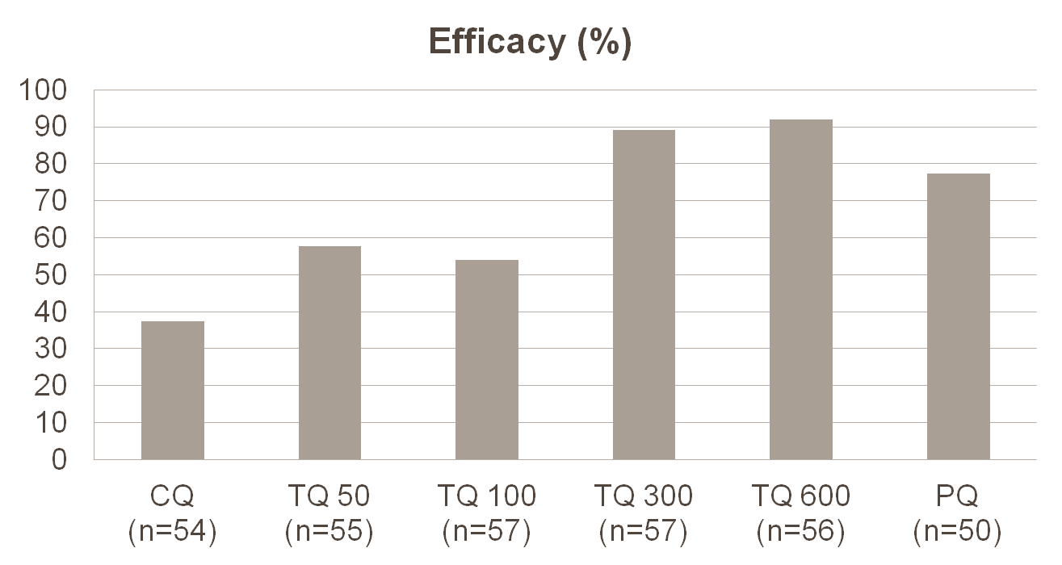
Primary Efficacy Results Show Convincing Efficacy at TQ 300mg and 600mg
(Recurrence-free Efficacy at 6 months: Kaplan-Meier Estimates)
89.2%
(p<0.0001)
91.9% (p<0.0001)
77.3%
(p=0.0004)
54.1%
(p=0.16)
57.7%
37.5%
Treatment Difference (95% CI) vs CQ (target=30%):
  TQ 600: 54.5% (38%,71%) TQ 300: 51.7% (35%,69%)
  TQ 100: 16.6% (-3%,36%) TQ 50: 20.3% (0%,40%)
  PQ: 39.9% (21%,59%)

Slide 69
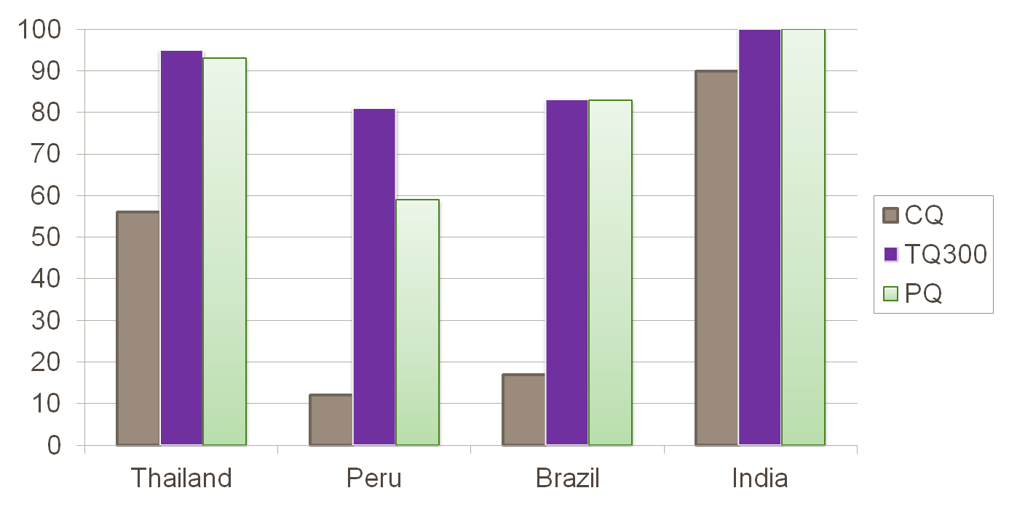
Regional differences in underlying relapse rates can impact absolute and comparative efficacy
N=99
38.5%
(12%, 65%)
N=136
69%
(46%, 91%)
N=37
67%
(24%, 100%)
N=57
10%
(-9%,29% )
TQ300 – CQ (95% CI):

Slide 70
Serious adverse events distributed evenly amongst treatment arms
 | CQ (N=54) | TQ50 (N=55) | TQ100 (N=57) | TQ300 (N=57) | TQ600 (N=56) | PQ (N=50)
ANY EVENT | 4 (7%) | 2 (4%) | 6 (11%) | 2 (4%) | 4 (7%) | 7 (14%)
ECG QT prolonged | 2 (4%) | 2 (4%) | 2 (4%) | 1 (2%) | 0 | 4 (8%)
Hb decreased | 1 (2%) | 0 | 0 | 0 | 1 (2%) | 1 (2%)
ALT increased | 1 (2%) | 0 | 0 | 0 | 0 | 0
Anaemia | 0 | 0 | 1 (2%) | 1 (2%) | 0 | 0
Methaemoglobinaemia | 0 | 0 | 0 | 0 | 0 | 1 (2%)
Pyelonephritis | 0 | 0 | 0 | 0 | 1 (2%) | 0
Scrub typhus | 0 | 0 | 0 | 0 | 1 (2%) | 0
Pyrexia | 0 | 0 | 1 (2%) | 0 | 0 | 0
Hepatitis acute | 0 | 0 | 0 | 0 | 0 | 1 (2%)
Dehydration | 0 | 0 | 1 (2%) | 0 | 0 | 0
Haemarthrosis | 0 | 0 | 0 | 0 | 1 (2%) | 0
Abortion induced | 0 | 0 | 1 (2%) | 0 | 0 | 0
Most of the SAEs were QT prolongations which were distributed across all treatment groups and were attributed to CQ treatment

Slide 71
future remarks...
Single treatment for Pv and Pf with ACT and primaquine?
Massive drug administration (which drugs? in which regimen?)
Re-introduction of malaria (good surveillance system)

Slide 72
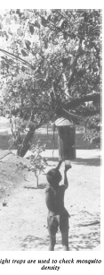


Slide 73


Slide 74

Genome published in 2008
Salvador I strain

Slide 75



















Uruguay 1930
Italy 1934
France 1938
Brazil 1950
Switzerland 1954
Uruguay
Italy
Italy
Uruguay
Germany
Sweden 1958
Chile 1962
England 1966
Mexico 1970
Germany 1974
Brazil
Brazil
England
Brazil
Germany
Argentina 1978
Spain 1982
Mexico 1986
Italy 1990
USA 1994
Argentina
Italy
Argentina
Germany
Brazil
France 1998
Korea Japan 2002
Germany 2006
South Africa 2010
Brazil 2014
France
Brazil
Italy
Spain
?????

Slide 76





marcuslacerda.br@gmail.com

